Slide 1

SKiIR Explanation Retrieval
Course: Information Retrieval
Lecturer: Alessandro Bozzon
Date: April 7, 2015
Team 7:
“Sophisticated Keyword Intelligent Information Retrieval”
Ruben Verboon
Herman Banken
Wiebe van Geest
Kors van Loon
Maarten Steinfort

Slide 2
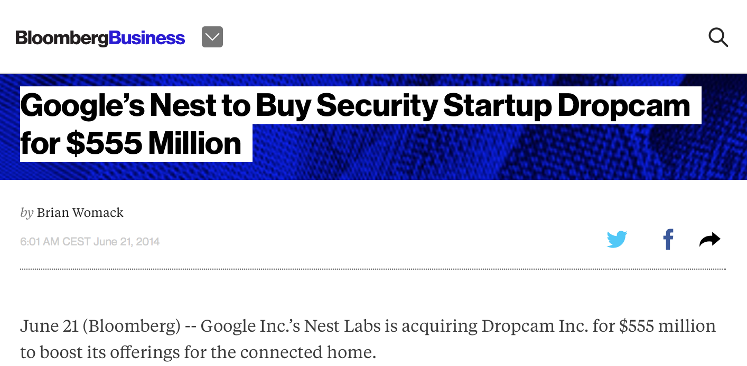
http://www.bloomberg.com/news/articles/2014-06-21/google-s-nest-buying-security-company-dropcam-for-555-million
Imagine…
You are reading an online newspaper about a new startup
company that has been bought up by Google.

Slide 3
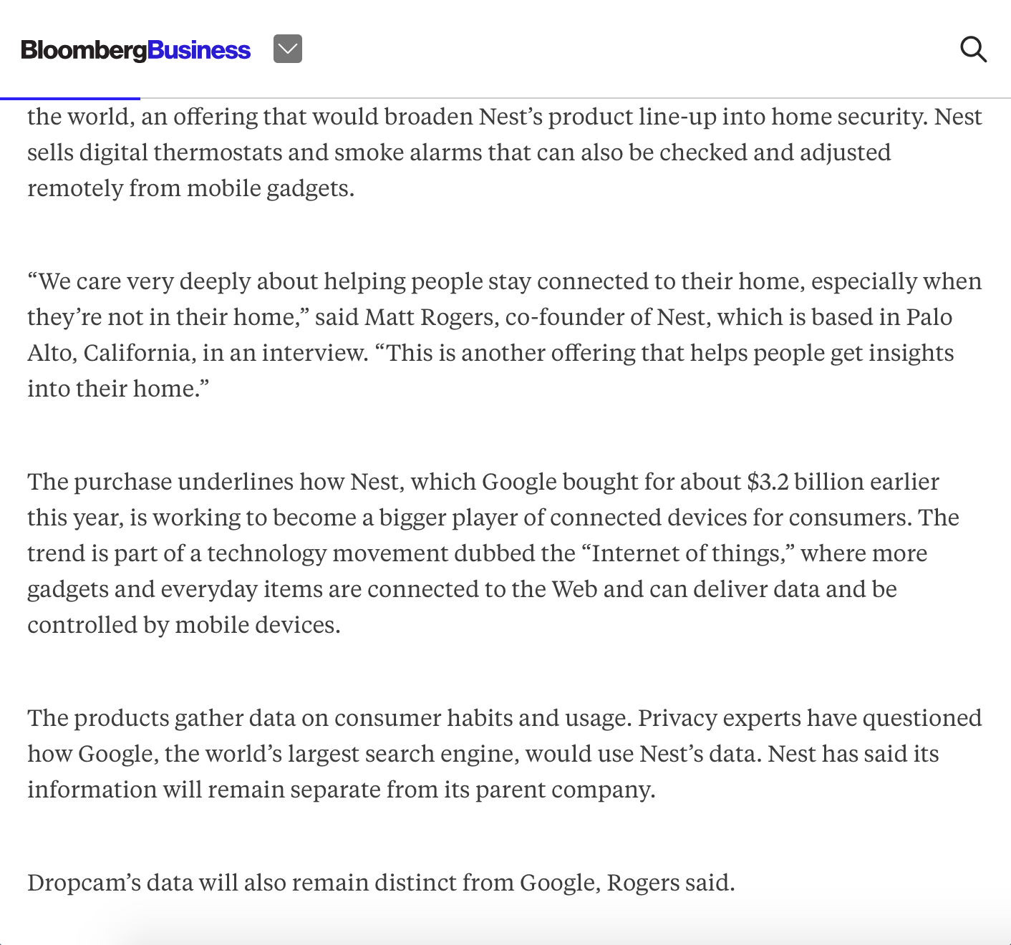

Slide 4
Wow, did I miss something?!
What is Nest?
Why did Google buy it for $3.2 billion dollars?
And now they are buying another company for $555 million dollars?
And.. what is the Internet of Things?
.. where more gadgets and everyday items are connected to the Web and can deliver data and controlled by mobile devices.

Slide 5

What would you do?
What is the Internet of Things?
Quit the article?!

Slide 6
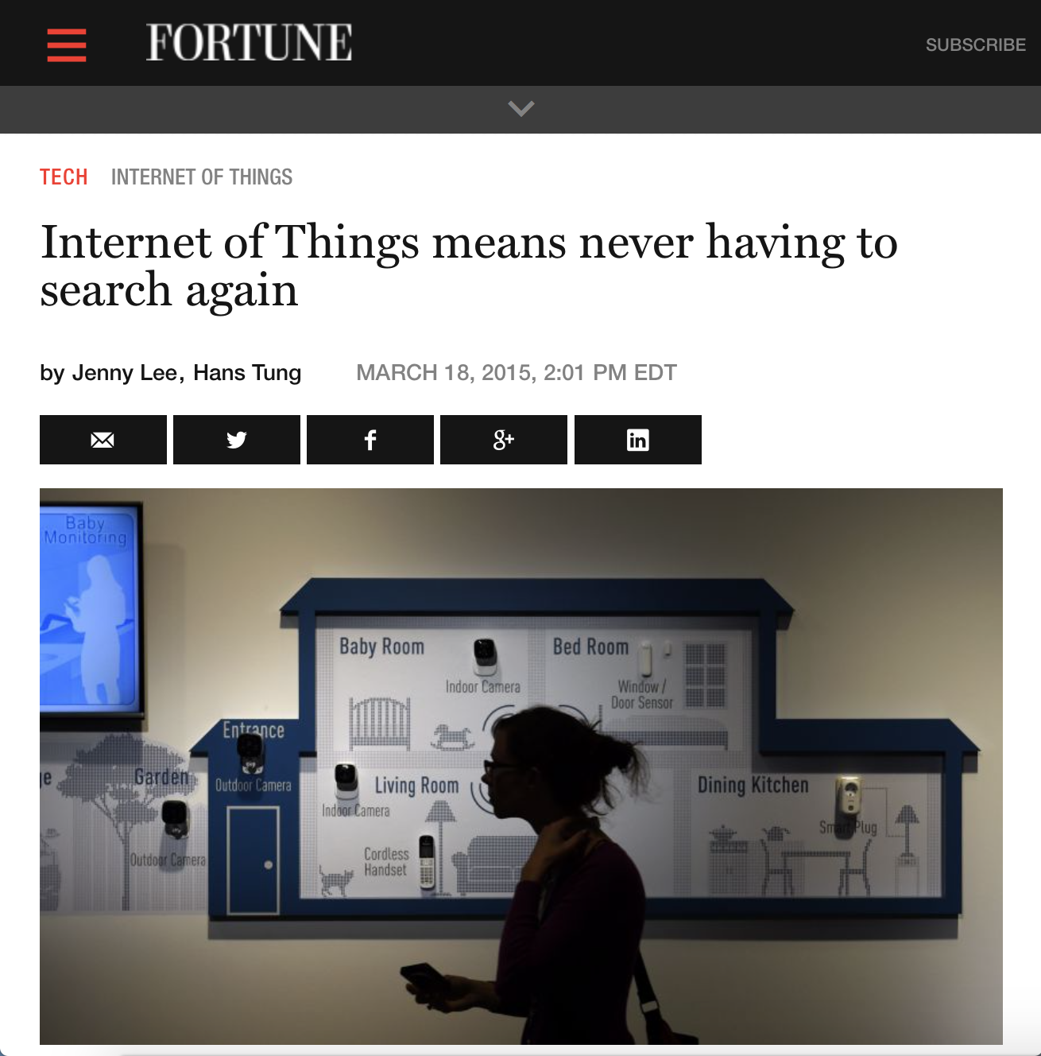
What would you do?
What is the Internet of Things?
Go to a competitor newspaper website?!

Slide 7
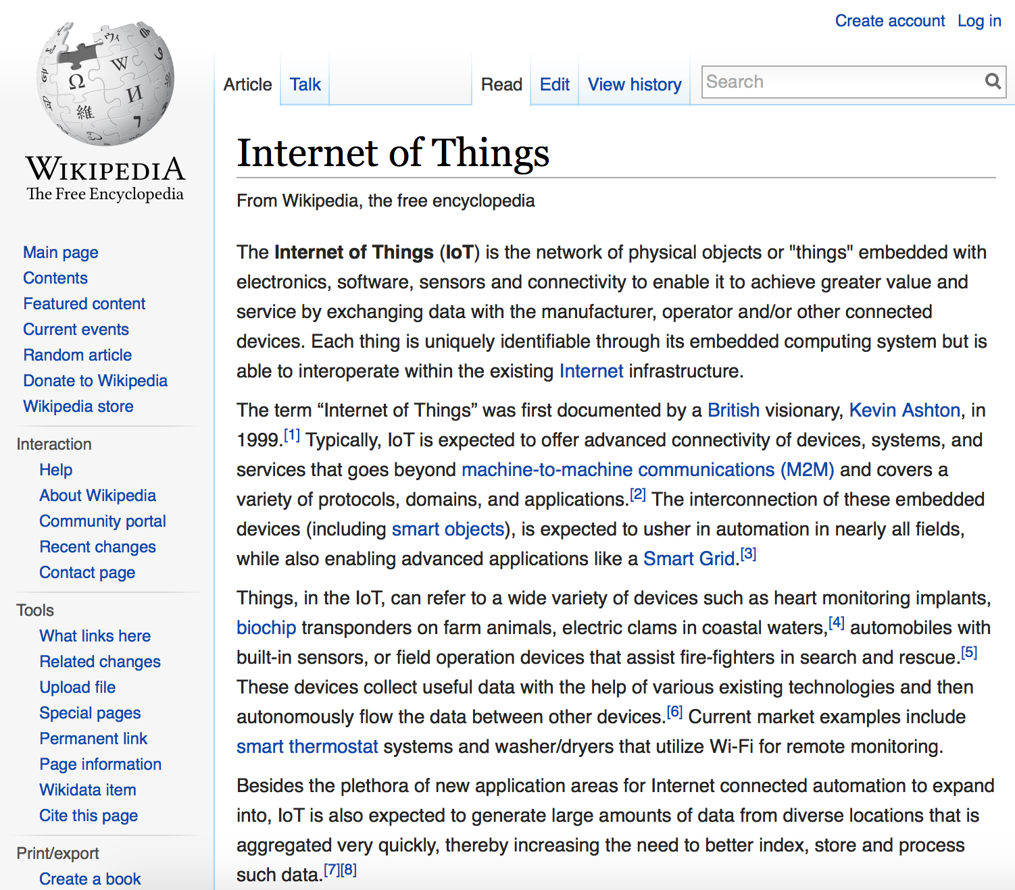


What would you do?
What is the Internet of Things?
Wouldn’t it be nice if someone could explain this to you?
Internet of Things is that all user objects are embedded with software and are connected and interacting with each other.
“It’s like that you can see on you iPhone what is in your fridge while your favorite music is played and lightning the candles automatically.”

Slide 8
So, we have a problem
News articles can be
too ‘complex’
whereby readers might leave
the website and go to
competitor news websites.

Slide 9
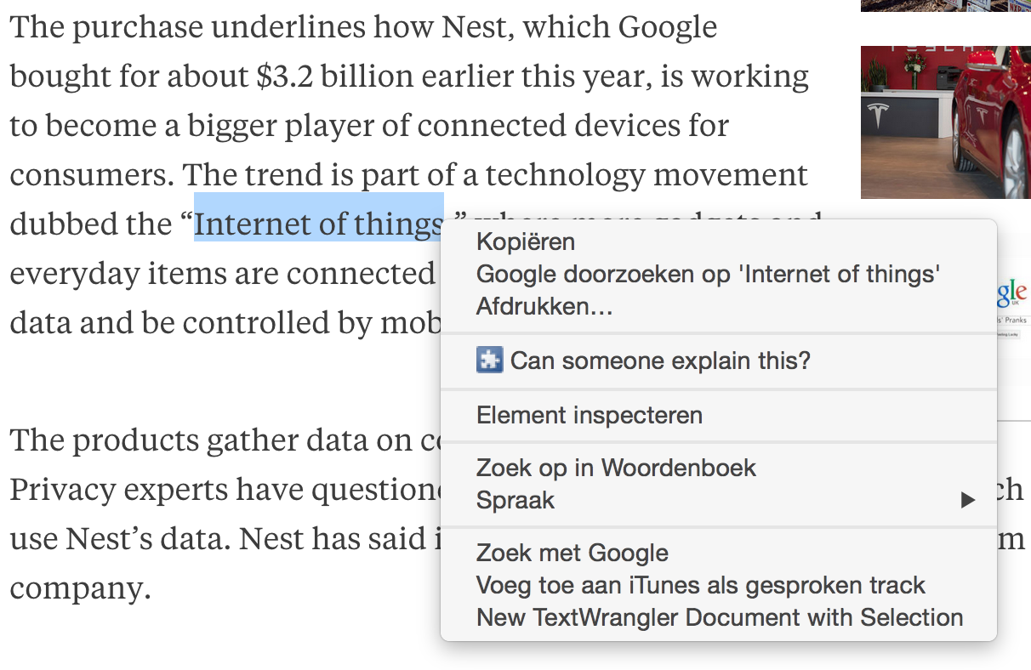
Wow, did I miss something?!
What is the Internet of Things?
Wouldn’t it be nice if someone could explain this to you online?

Slide 10
Goal
To
broaden the audience
of our news website by
explaining ‘complex’ terms
with online annotations.

Slide 11
News articles can be
too ‘complex’
whereby readers might leave
the website and go to
competitor news websites.
Problem
Goal
Solution
To
broaden the audience
of our news website by
explaining ‘complex’ terms
with online annotations.
How to solve?!

Slide 12


Solution
SKiIR
Powered by
‘Explanation Retrieval’
Manual explanations Readers explain terms that other readers don’t understand
Automatic explanations Retrieving related articles with semantic searching
Human Computation
Information Retrieval
But… Human Computation is scarce!!

Slide 13

Project Organization
Defining
Designing
Developing
Presenting
Problem
Goal
Solution
Scope
Design
Require-ments
IR and HC techniques
MVP
Testing
Presenting
Demo
Sell it!

Slide 14




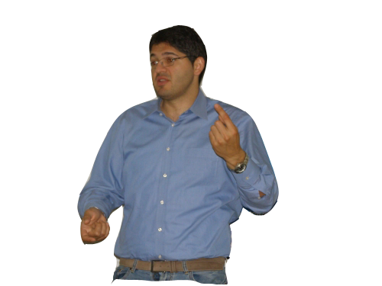


Design choices
SKiIR-app
Scope
Web Application
Chrome Extension
News articles
Bloomberg
Back-end &
Database
Play Framework &
PostGreSQL
Human Computation
Readers
AlchemyAPI &
DBPedia &
New learnings
IR Model

Slide 15
Features - What should it do?
0. Scrape news articles
Request explanation
Semantically retrieve explanations
Provide explanation
Review explanation

Slide 16
Workflow - How should it work?
0. Scrape news articles
Scrape news article
Store article info
Scrape entities

Slide 17
Workflow - How should it work?
1. Request explanation
Request explanation
Store request
Instant explanation
(See step 2)

Slide 18
Workflow - How should it work?
2. Semantically retrieve explanation - automatically
Explanation request
Store explanation
All articles
Explanation from relevant articles

Slide 19
Workflow - How should it work?
3. Provide explanation - manually
Explanation request
Provide explanation
Store explanation
All articles
Relevant articles

Slide 20
Workflow - How should it work?
4. Review explanation
Vote explanation
Show explanation
Provide alternative
(see step 3)
Store review

Slide 21
Workflow – Functional overview

Slide 22
Explanation Retrieval
Extraction of requisites
Relevance of terms
SCS Connector
Adding diversity
Ranking results

Slide 23
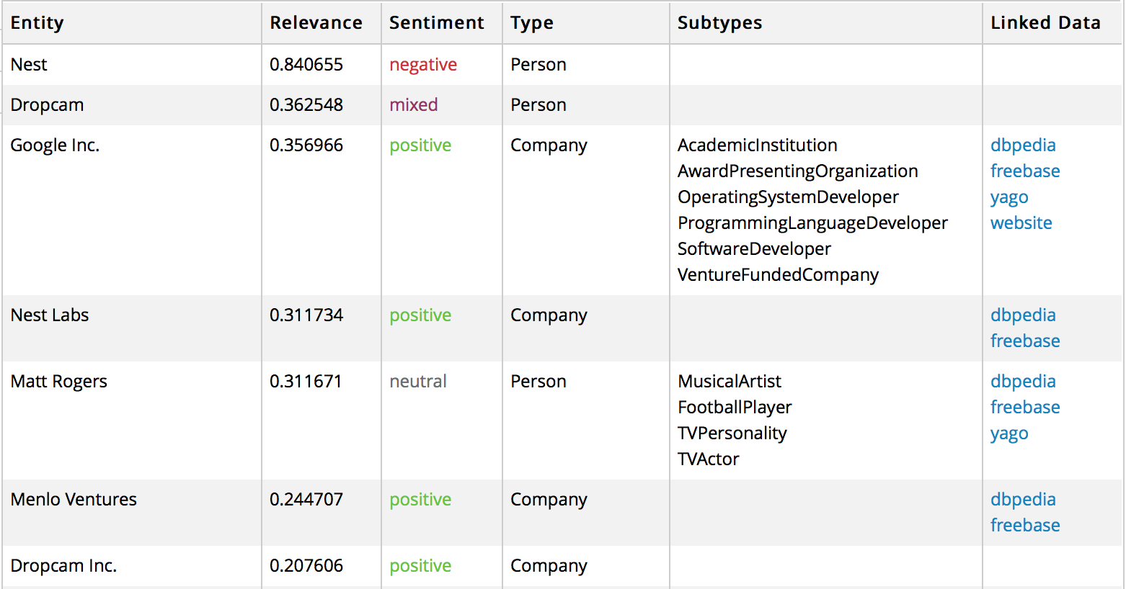
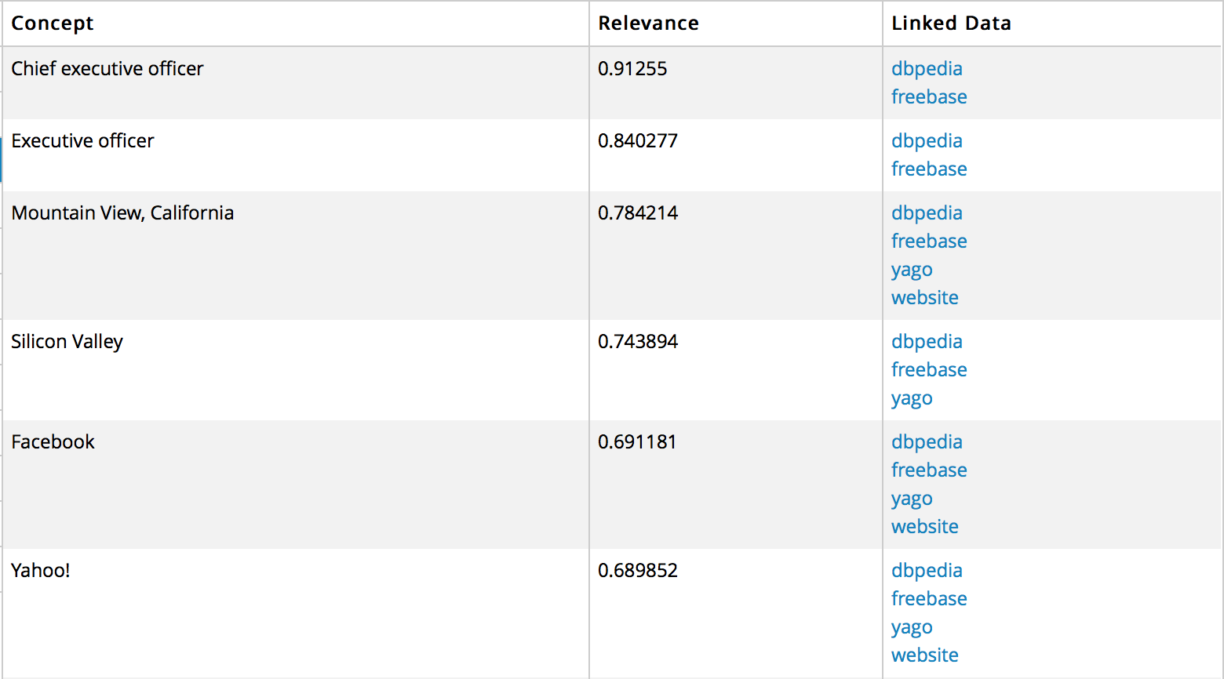
Extraction of Requisites
Entities
Concepts
Linked Data
Relevance
Source:

Slide 24
Ranking Results
Combining all to rank the articles on total relevance

Slide 25
Relevance of terms
Relevance of terms in a specific article
0,35
Petrobras creditors could request an acceleration of payments on some of its debt if the company doesn’t release an audited financial statement by the end of May.
Public prosecutors are investigating 20 companies, including 16 builders, for participating in a alleged cartel to overcharge the oil company. OAS and Galvao Engenharia SA, Brazilian construction companies, filed for bankruptcy after investigations started.
The president said the builders financial difficulties won’t hold up planned tenders to build and operate infrastructure projects. She said she plans tap Chinese investment for a railway linking Brazil’s Atlantic coast with the Pacific Ocean.
The Supreme Court has also authorized investigations of 49 politicians including Senate chief Renan Calheiros and lower house President Eduardo Cunha in relation to the alleged kickbacks at Petrobras. Former officials at the company turned state’s witness said that hundreds of millions of dollars went to political parties, including Rousseff Workers’ Party. The scandal has eroded the support she needs in Congress to approve austerity measures.
0,63
0,11
0,88
0,78
0,63

Slide 26
SCS Connector
Relationship between entities
Petrobras creditors could request an acceleration of payments on some of its debt if the company doesn’t release an audited financial statement by the end of May.
Public prosecutors are investigating 20 companies, including 16 builders, for participating in a alleged cartel to overcharge the oil company. OAS and Galvao Engenharia SA, Brazilian construction companies, filed for bankruptcy after investigations started.
The president said the builders financial difficulties won’t hold up planned tenders to build and operate infrastructure projects. She said she plans tap Chinese investment for a railway linking Brazil’s Atlantic coast with the Pacific Ocean.
The Supreme Court has also authorized investigations of 49 politicians including Senate chief Renan Calheiros and lower house President Eduardo Cunha in relation to the alleged kickbacks at Petrobras. Former officials at the company turned state’s witness said that hundreds of millions of dollars went to political parties, including Rousseff Workers’ Party. The scandal has eroded the support she needs in Congress to approve austerity measures.
0,23
0,56
0,76
0
0,83

Slide 27
Ranking Results
Combining all to rank the articles on total relevance

Slide 28
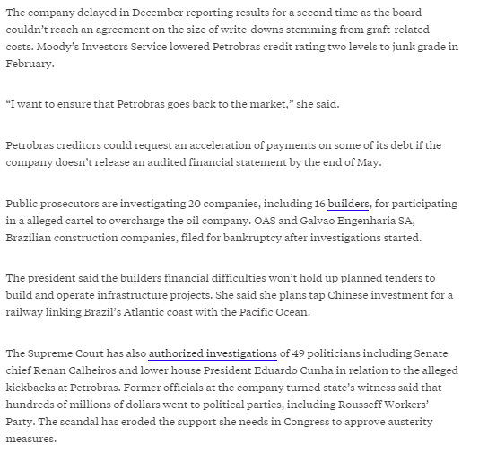
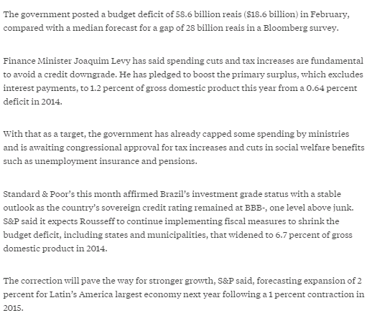
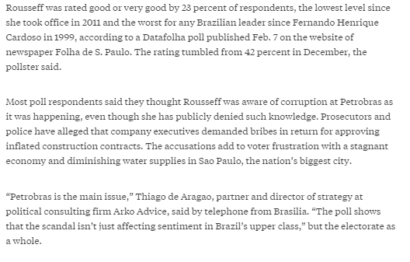
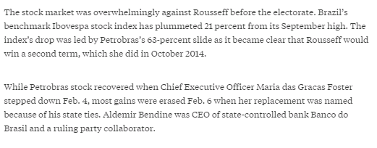
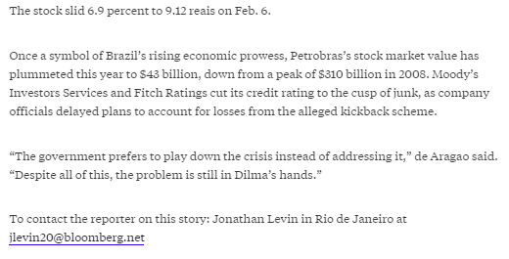
Adding Diversity
Maximal Marginal Relevance (MMR) method
Max Relevance vs Min Relevance
Original document
Other results

Slide 29
Demonstration
SKiIR Explanation Retrieval
See the application!
Powered by

Slide 30
Reflection - Accomplishments
SKiIR-app
Minimal Viable Product
Manual explanations Readers explain terms that other readers don’t understand
Automatic explanations Retrieving related articles with semantic searching
Human Computation
Explanation Retrieval

Slide 31
Selling points
SKiIR-app
Why should a newspaper use it?!
Broaden the audience of your newspaper
Extend visiting times
Expand number of visitors
Why should a reader use it?!
More accessible news articles
More background information
Reading pay-walled articles for free

Slide 32
How to incentivize readers?
Expert points
Allocating expert points for (high) voted explanations
Pay-walled articles
Granting free access to pay-walled articles
CrowdFlower
Paying for explanations

Slide 33
Reflection
Manual explanations Readers explain terms that other readers don’t understand
Automatic explanations Retrieving related articles with semantic searching
Human Computation
V S
Information Retrieval
Better explanations
Supported by relevant articles
Context
Consistent (bad intention)
Slower response
Incentivizing is difficult
Instant response
Consistent
Based on relevant articles
Context
‘Computer-ish’ explanations

Slide 34
Reflection – Difference with initial requirements
Initial state ←→ Current state
Simplified IR
Complete ‘explanation’ ←→ Sentences from relevant articles
Measuring success
Usage statistics ←→ Testing software functionality
Integration
CrowdFlower ←→ Independent browser extension
Expert incentivizing
Reward expert points ←→ No expert incentivizing

Slide 35
Reflection - Problems
Scope
Defining exact requirements of the design
Design
Not relying only on Human Computation
Teamwork
Integration of different system parts
Communication
Minimal Viable Product
Sophisticating the Information Retrieval model

Slide 36
Reflection – Future work and research
Improve semantic search model
Learning from the great ones (Google News search)
Define business model
How to enter the market?
(Sell it to newspapers or publish extension?)
Incentivizing readers to explain
Earning ‘expert status’
Access to pay-walled articles
More measurements?

Slide 37
Bibliography
Bozzon. (2015). Syllabus IN4325. TU Delft.
Ceri, Bozzon, & etAlumni. (2013). Web Information Retrieval. Springer.
Law, & Ahn, v. (2011). Human Computation. Morgan & Claypool.
Nunes & et Alumni. (2014). SCS Connector – Quantifying and Visualising Semantic Paths Between Entity Pairs.

